Slide 1
INTRODUCTION TO USER INTERFACE
Irfansjah
081293728732

Slide 2
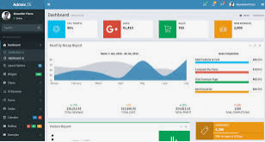
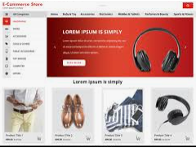

THE CONCEPT OF LAYOUT

Slide 3
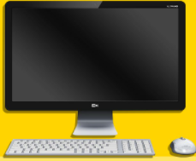
THE CONCEPT OF LAYOUT
Layout : the way in which the parts of something are arranged or laid out. the arrangement of visual elements on a page.
Elements :
Text
Image
Media
Coordinate System
Cartessian System
0,0
Color Compositions
0,0

Slide 4
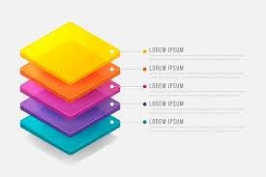
THE CONCEPT OF LAYOUT
Layout : the way in which the parts of something are arranged or laid out. the arrangement of visual elements on a page.
Layers

Slide 5

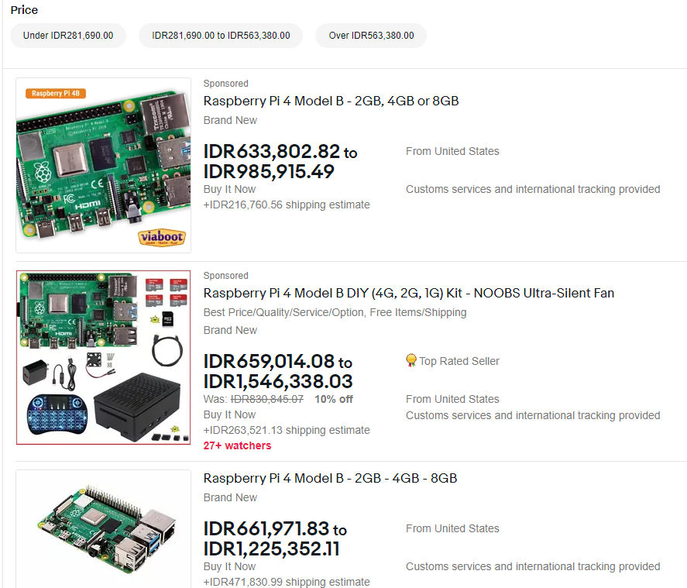
THE CONCEPT OF LAYOUT
Basic Web Application Layout
TABULAR LAYOUT
GRID LAYOUT

Slide 6

THE CONCEPT OF LAYOUT
Basic Web Application Layout
COLUMN LAYOUT

Slide 7
COMMON BOX ELEMENTS
MARGIN
ELEMENT
BORDER
PADDING

Slide 8
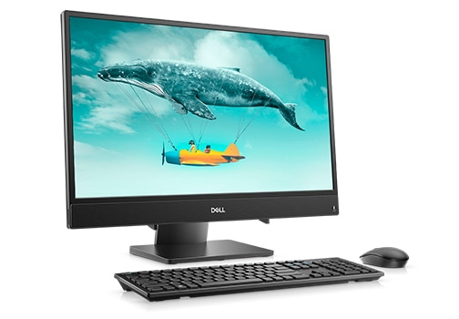
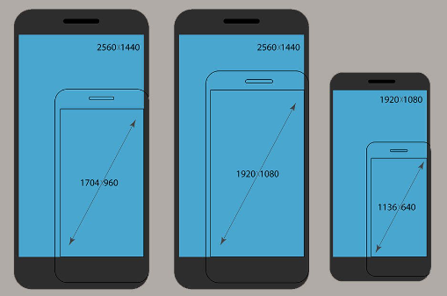
SCREEN SIZE
SCREEN SIZE ARE MEASURED BY ITS WIDTH AND HEIGHT
USER INTERFACE DESIGN WE ARE USING PIXELS AS A BASE METRICS
19-inch screen (standard ratio): 1280 x 1024 pixels.
20-inch screen (standard ratio): 1600 x 1200 pixels.
22-inch screen (widescreen): 1680 x 1050 pixels.
24-inch screen (widescreen): 1900 x 1200 pixels.

